Slide 1
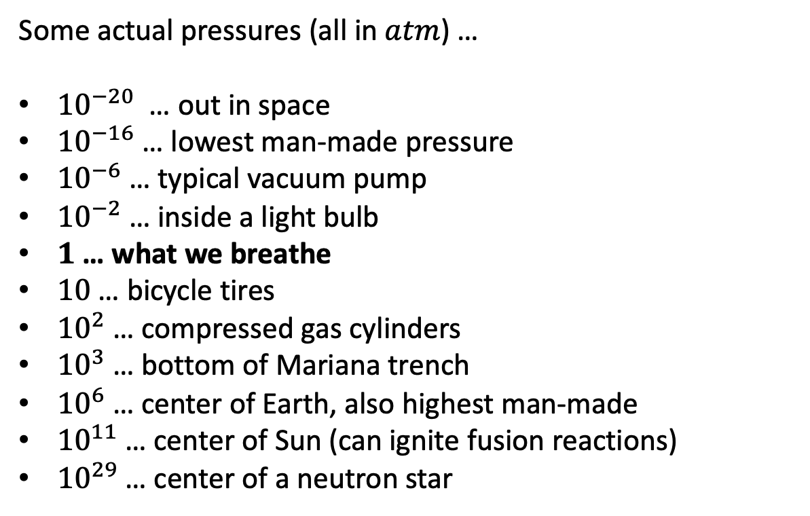
Pressure: common units and extreme values
Some actual pressures (all in $atm$) …
${10}^{−20}$ … out in space
${10}^{−16}$… lowest man-made pressure
${10}^{−6}$… typical vacuum pump
${10}^{−2}$… inside a light bulb
$1$ … what we breathe
$10$… bicycle tires
${10}^{2}$… compressed gas cylinders
${10}^{3}$… bottom of Mariana trench
${10}^{6}$… center of Earth, also highest man-made
${10}^{11}$… center of Sun (can ignite fusion reactions)
${10}^{29}$… center of a neutron star
Pascal (SI)
torr
bar
atm
http://kuno.crc.nd.edu/wordpress/wp-content/uploads/2018/02/Chem332_Spring_13.pdf

Slide 2

Pressure: conversions
Pascal (SI)
torr
bar
atm
$1 Pa={10}^{−5} bar=0.987 × {10}^{−5} atm$(so a Pascal is a tiny unit of pressure)
Let’s do a conversion of the pressure inside a light bulb:
$$P_{vacuum pump}={10}^{−6} atm × \left(\frac{}{}\right)$$

Slide 3
Pressure: conversions
Pascal (SI)
torr
bar
atm
$1 Pa={10}^{−5} bar=0.987 × {10}^{−5} atm$(so a Pascal is a tiny unit of pressure)
Let’s do a conversion of the pressure inside a light bulb:
$$P_{vacuum pump}={10}^{−6} atm × \left(\frac{1 Pa}{0.987 × {10}^{−5} atm}\right)$$

Slide 4
Pressure: conversions
Pascal (SI)
torr
bar
atm
$1 Pa={10}^{−5} bar=0.987 × {10}^{−5} atm$(so a Pascal is a tiny unit of pressure)
Let’s do a conversion of the pressure inside a light bulb:
$$P_{vacuum pump}={10}^{−6} atm × \left(\frac{1 Pa}{0.987 × {10}^{−5} atm}\right)=1.01 Pa$$

Slide 5
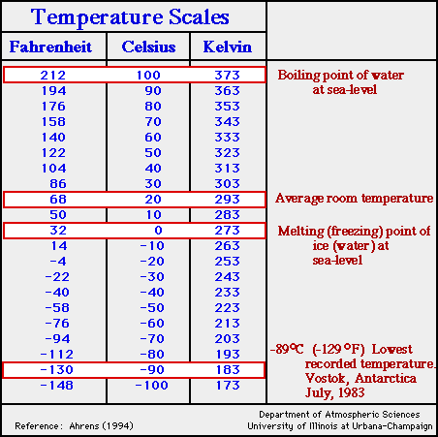
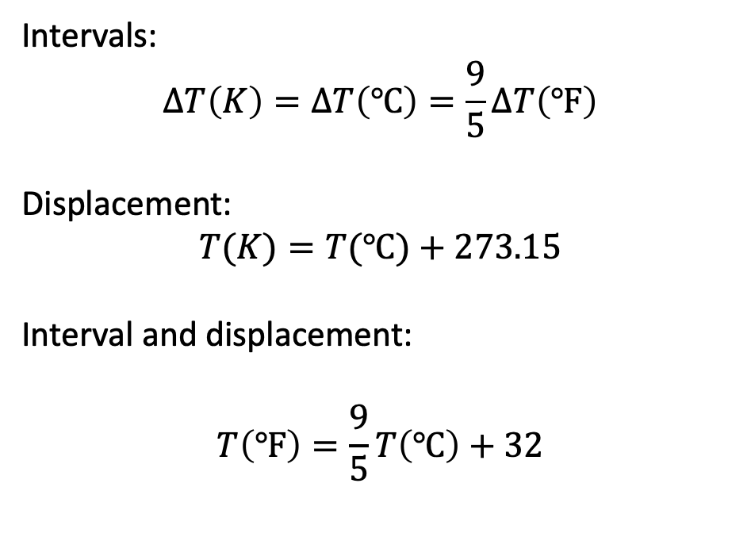
Temperature: common units and extreme values
Fahrenheit
Celsius
Kelvin (SI)
Intervals:
$$∆T\left(K\right)=∆T\left(℃\right)=\frac{9}{5}∆T\left(℉\right)$$
Displacement:
$$T(K)=T(℃)+273.15$$
Interval and displacement:
$$T\left(℉\right)=\frac{9}{5}T\left(℃\right)+32$$
https://3.bp.blogspot.com/-4vi6Gqnsd1g/VGLcTzhQqWI/AAAAAAAAACs/2kesKaFsY2U/s1600/temp.scales.gif

Slide 6
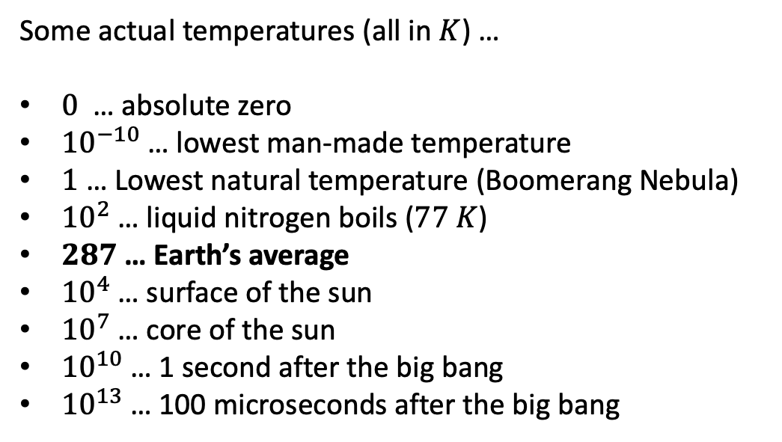
Temperature: common units and extreme values
Fahrenheit
Celsius
Kelvin (SI)
Some actual temperatures (all in $K$) …
$0$ … absolute zero
${10}^{−10}$… lowest man-made temperature
$1$… Lowest natural temperature (Boomerang Nebula)
${10}^{2}$… liquid nitrogen boils ($77 K$)
$287$… Earth’s average
${10}^{4}$… surface of the sun
${10}^{7}$… core of the sun
${10}^{10}$… 1 second after the big bang
${10}^{13}$… 100 microseconds after the big bang
Intervals:
$$∆T\left(K\right)=∆T\left(℃\right)=\frac{9}{5}∆T\left(℉\right)$$
Displacement:
$$T(K)=T(℃)+273.15$$
Interval and displacement:
$$T\left(℉\right)=\frac{9}{5}T\left(℃\right)+32$$
https://3.bp.blogspot.com/-4vi6Gqnsd1g/VGLcTzhQqWI/AAAAAAAAACs/2kesKaFsY2U/s1600/temp.scales.gif

Slide 7
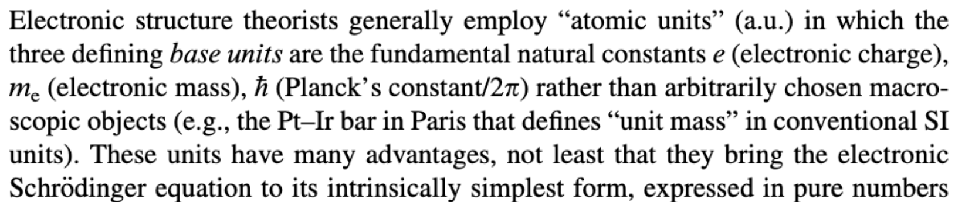
Self-consistent (“coherent”) unit systems
SI
Established and maintained^{[12]} by the General Conference on Weights and Measures^{[j]} (CGPM^{[k]}), it is the only system of measurement with an official status^{[m]} in nearly every country in the world,^{[n]} employed in science, technology, industry, and everyday commerce.
https://en.wikipedia.org/wiki/International_System_of_Units
Atomic units
https://onlinelibrary.wiley.com/doi/pdf/10.1002/9781118229101.app5

Slide 8
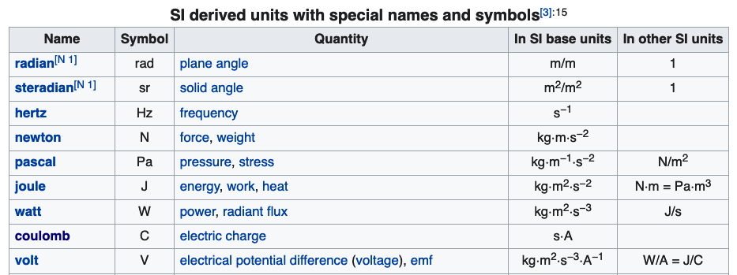
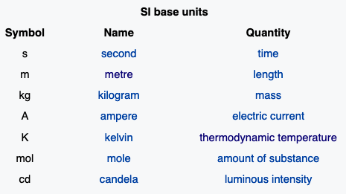
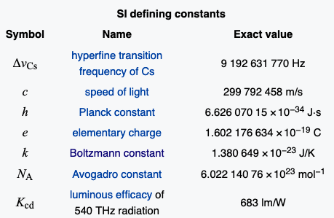
All self-consistent unit systems have three features in common
Derived units
Base units
Defining constants

Slide 9
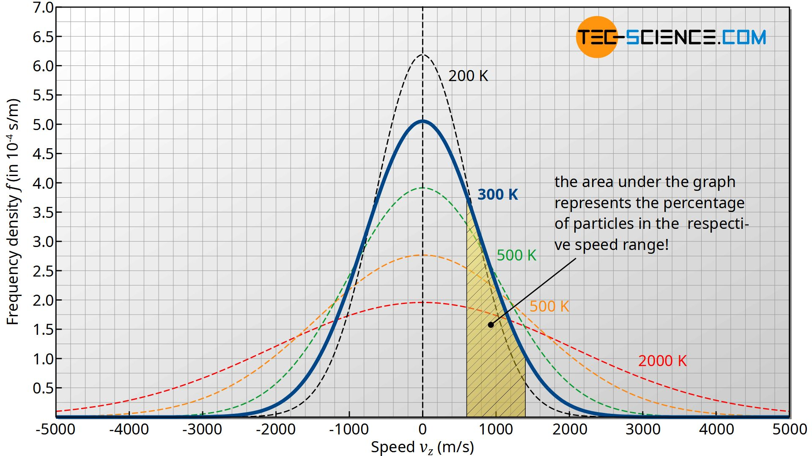
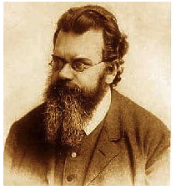
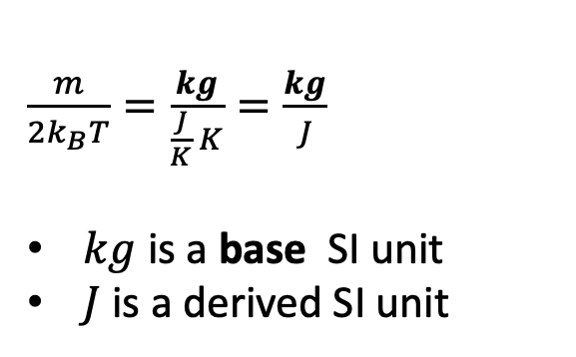
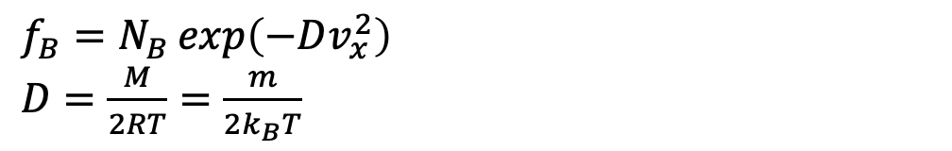


Analysis of the Boltzmann function
$$f_{B}=N_{B}\exp\left(−Dv_{x}^{2}\right)$$
$D=\frac{M}{2RT}=\frac{m}{{2k}_{B}T}$
⇒ $D$ should have dimensions speed⁻². Can you prove it?
$$v_{x} (m/s)$$
$\frac{m}{2k_{B}T}=\frac{kg}{\frac{J}{K} K}=\frac{kg}{J}$
$kg$ is a base SI unit
$J$ is a derived SI unit

Slide 10
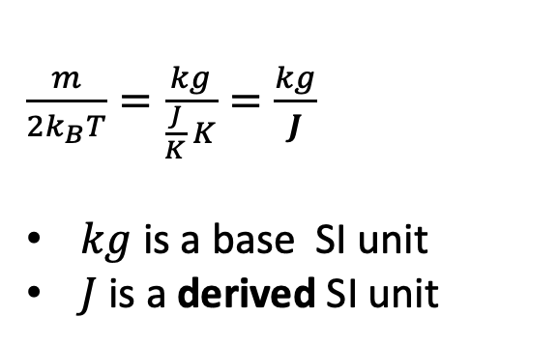
Analysis of the Boltzmann function
$$f_{B}=N_{B}\exp\left(−Dv_{x}^{2}\right)$$
$D=\frac{M}{2RT}=\frac{m}{{2k}_{B}T}$
⇒ $D$ should have dimensions speed⁻². Can you prove it?
$$v_{x} (m/s)$$
$\frac{m}{2k_{B}T}=\frac{kg}{\frac{J}{K} K}=\frac{kg}{J}$
$kg$ is a base SI unit
$J$ is a derived SI unit

Slide 11
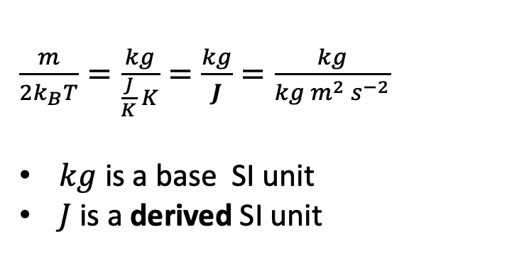
Analysis of the Boltzmann function
$$f_{B}=N_{B}\exp\left(−Dv_{x}^{2}\right)$$
$D=\frac{M}{2RT}=\frac{m}{{2k}_{B}T}$
⇒ $D$ should have dimensions speed⁻². Can you prove it?
$$v_{x} (m/s)$$
$\frac{m}{2k_{B}T}=\frac{kg}{\frac{J}{K} K}=\frac{kg}{J}=\frac{kg}{kg m^{2} s^{−2}}$
$kg$ is a base SI unit
$J$ is a derived SI unit

Slide 12
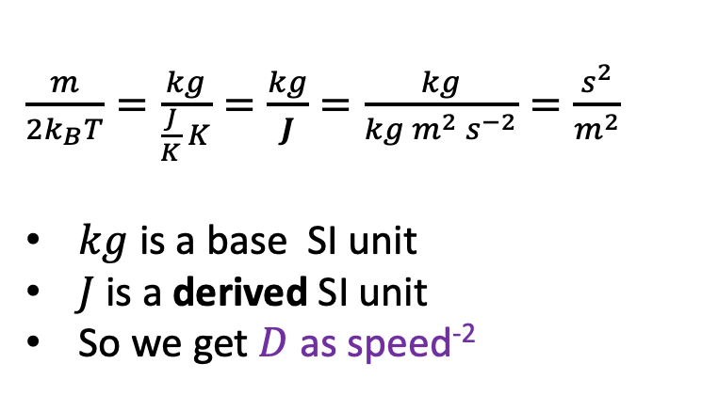
Analysis of the Boltzmann function
$$f_{B}=N_{B}\exp\left(−Dv_{x}^{2}\right)$$
$D=\frac{M}{2RT}=\frac{m}{{2k}_{B}T}$
⇒ $D$ should have dimensions speed⁻². Can you prove it?
$$v_{x} (m/s)$$
$\frac{m}{2k_{B}T}=\frac{kg}{\frac{J}{K} K}=\frac{kg}{J}=\frac{kg}{kg m^{2} s^{−2}}=\frac{s^{2}}{m^{2}}$
$kg$ is a base SI unit
$J$ is a derived SI unit
So we get $D$ as speed⁻²

Slide 13
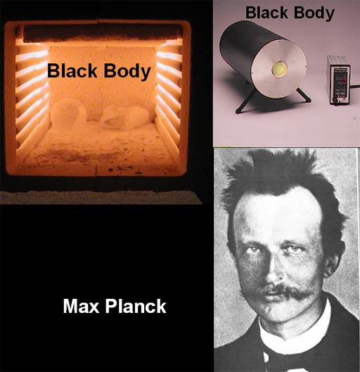
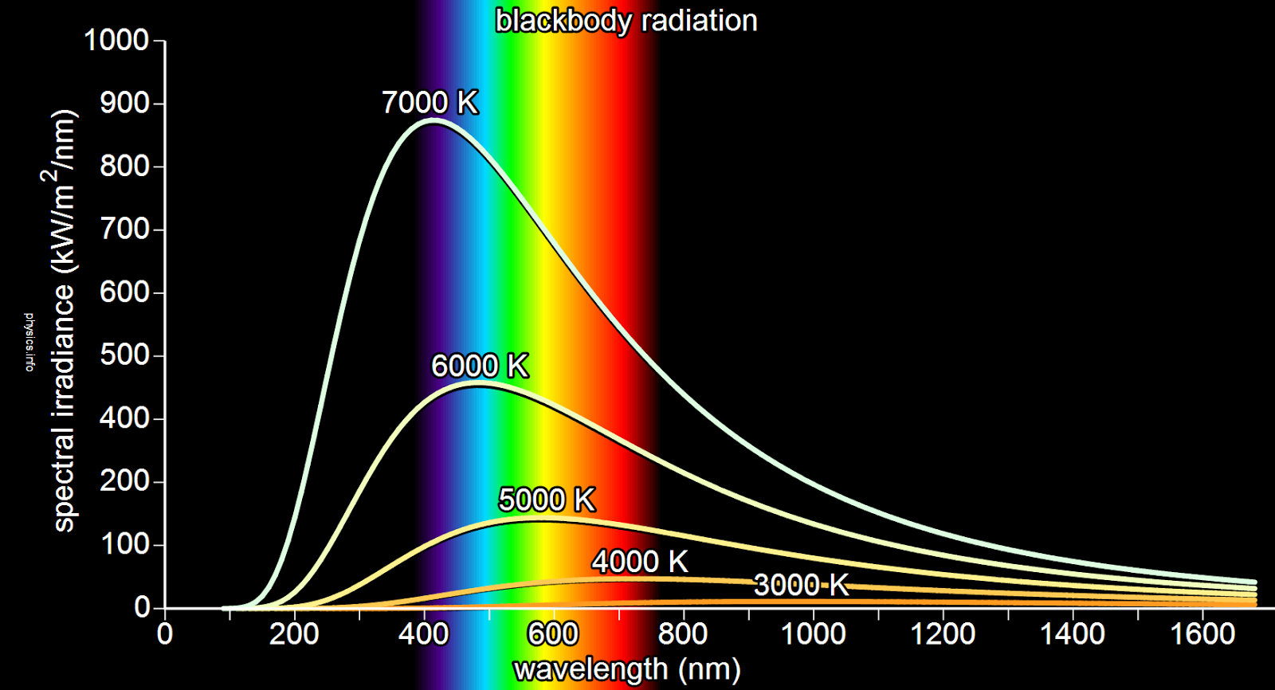
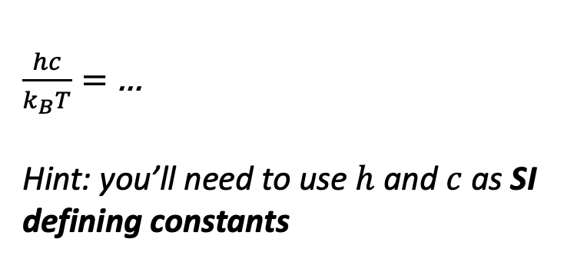


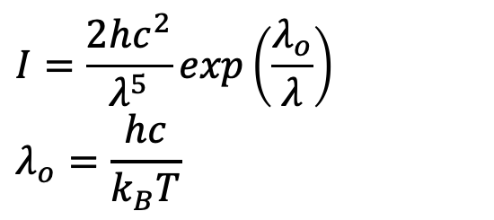
Analysis of the Planck function
$$I=\frac{2hc^{2}}{λ^{5}}\exp\left(\frac{λ_{o}}{λ}\right)$$
$$λ_{o}=\frac{hc}{k_{B}T}$$
⇒$λ_{o}$should have dimensions distance. Can you prove it?
$$λ (nm)$$
$\frac{hc}{k_{B}T}=$ …
Hint: you’ll need to use $h$ and $c$ as SI defining constants

Slide 14
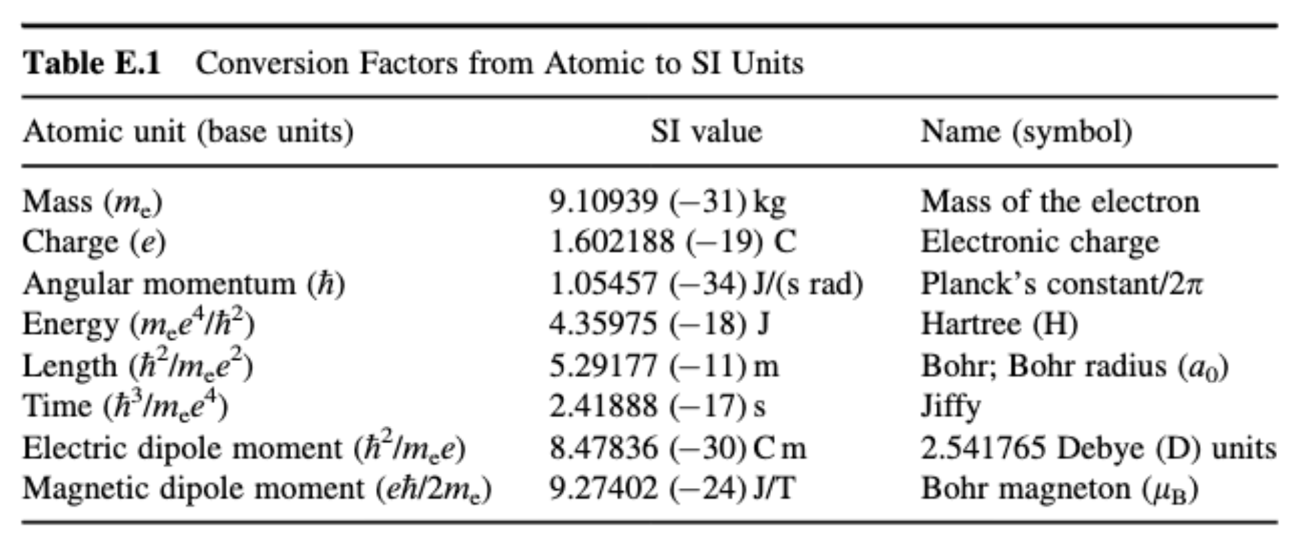
Atomic and SI unit conversions
https://onlinelibrary.wiley.com/doi/pdf/10.1002/9781118229101.app5

